Slide 1
HTTP Request
Head Request
Options Request
Patch Request
1
Get Request
Post Request
Put Request
Delete Request
5
2
6
3
7
4

Slide 2
Get Request
GET requests are used to read either a single or a collection resource
GET requests for individual resources will usually generate a 404 if the resource does not exist
GET requests for collection resources may return either 200 (if the collection is empty) or 404 (if the collection is missing)
GET requests must NOT have a request body payload (see GET with body)

Slide 3
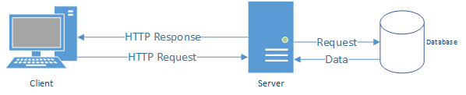
Get Request

Slide 4
PUT Request
PUT requests are used to update entire resources
PUT requests are usually applied to single resources, and not to collection resources, as this would imply replacing the entire collection
PUT requests are usually robust against non-existence of resources by implicitly creating the resource before updating
on successful PUT requests, the server will replace the entire resource addressed by the URL with the representation passed in the payload (subsequent reads will deliver the same payload, plus possibly server-generated fields like modified_at)
successful PUT requests return 200 or 204 (if the resource was updated - with or without returning the resource), 201 (if the resource was created) or 202 (if accepted and processed asynchronously).

Slide 5
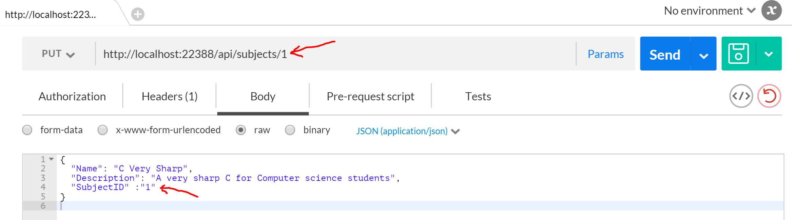
PUT Request

Slide 6
POST Request
POST requests are idiomatically used to create single resources on a collection resource endpoint
on a successful POST request, the server will create one or multiple new resources and provide their URI/URLs in the response
successful POST requests return 200 or 204 (if the resource was updated - with or without returning the resource), 201 (if the resource was created) or 202 (if accepted and processed asynchronously).

Slide 7
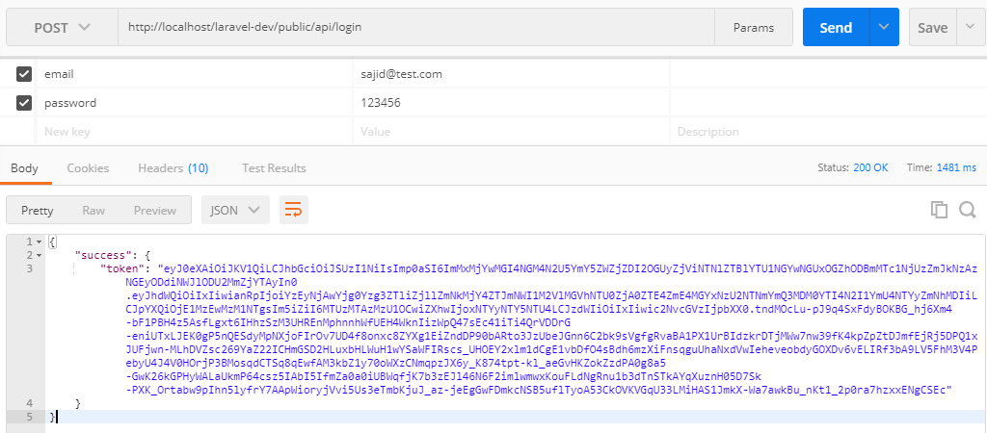
POST Request

Slide 8
Delete Request
DELETE requests are used to delete resources
DELETE requests are usually applied to single resources, not on collection resources, as this would imply deleting the entire collection.
DELETE request can be applied to multiple resources at once using query parameters on the collection resource (see DELETE with query parameters).
successful DELETE requests return 200 or 204 (if the resource was deleted - with or without returning the resource).
failed DELETE requests will usually generate 404 (if the resource cannot be found) or 410 (if the resource was already deleted before).

Slide 9
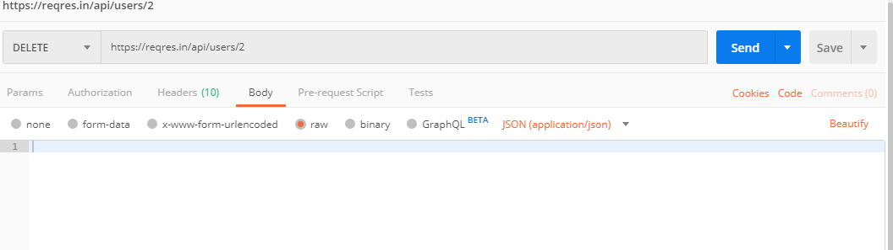
Delete Request

